Slide 1
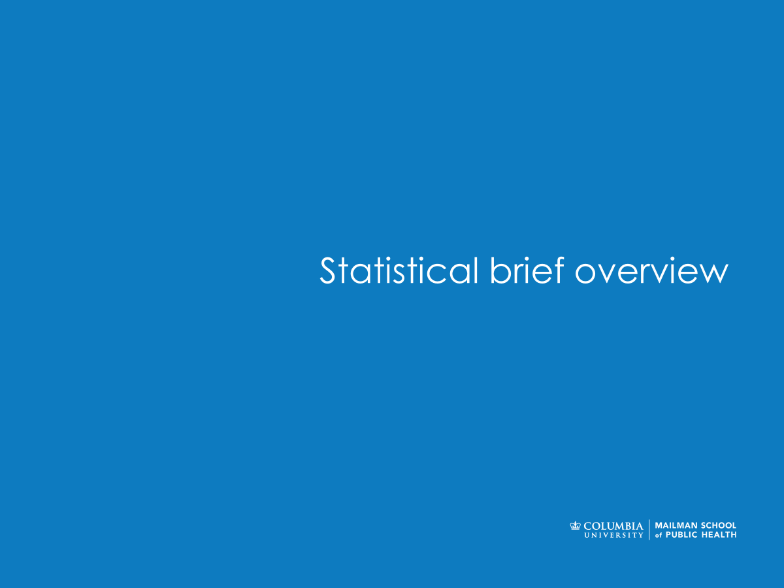

Computing in Context: Fall 2024
Lab 10 |Split-Apply-Combine
Statistical brief overview
Dr Sarah Ashcroft-Jones | Mailman School of Public Health

Slide 2
Main operations in pandas
Combine information across tables (join, anti-join)
• Join: e.g., combine tables from multiple sources
• Anti-join: e.g., outliers, exclude them from the existing table
Compute summary tables (split-apply-combine)
• E.g., compute average measurement

Slide 3
How to split-apply-combine?
Most tabular data tools (including Python) have a way to vectorize the standard split-apply-combine operations, using a “group-by” command
In addition, Pandas has the “pivot-table” command that can be used to simplify the creation of more complex summary tables (we have seen this before).

Slide 4
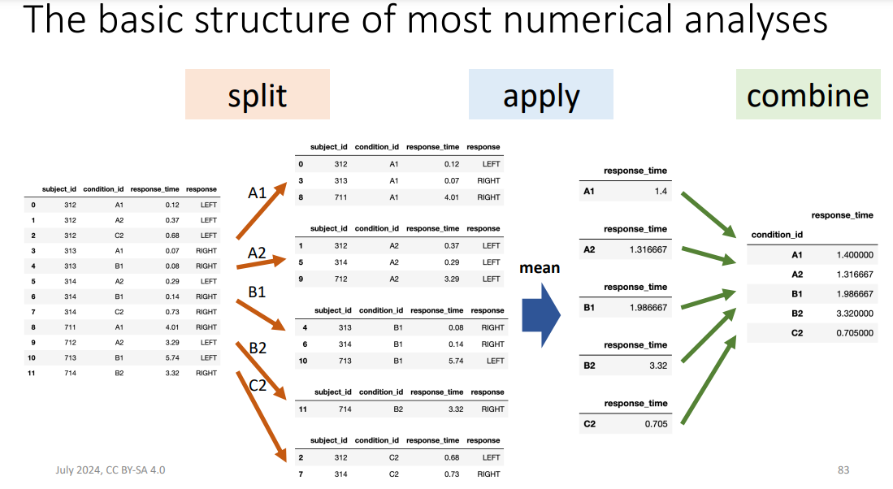
The basic structure of most analyses

Slide 5
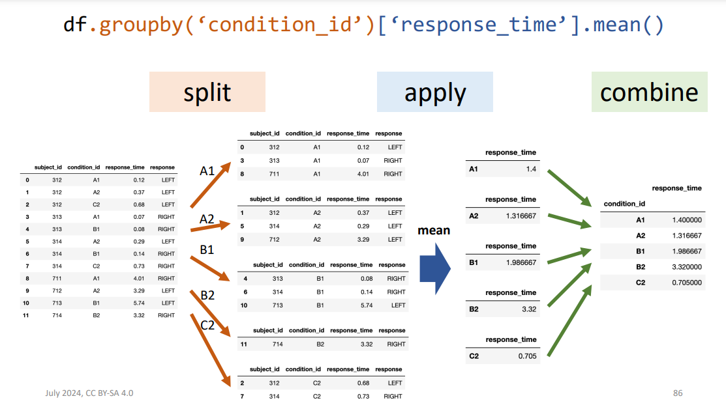

Slide 6
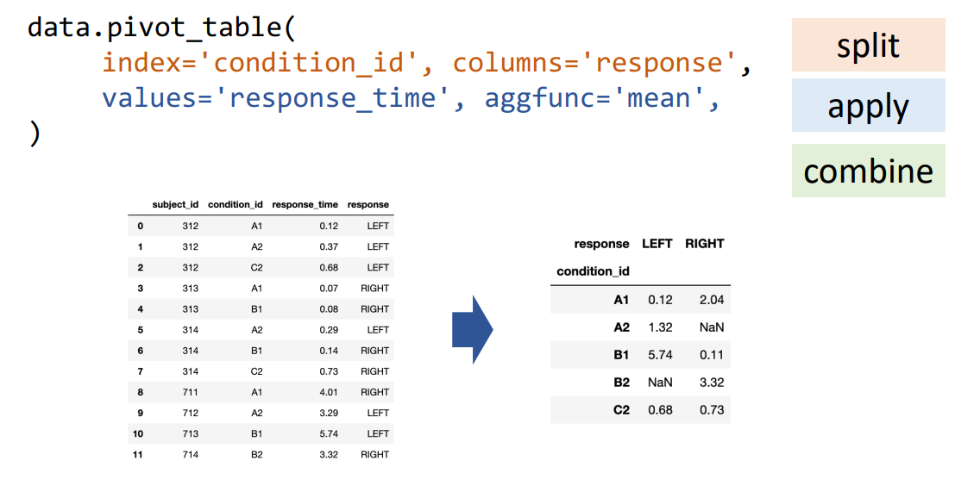

Slide 7

Statistical brief overview
Hands on practice:
download Jupyter Notebooks + data

